Slide 1
COMP 2230
Week 7 - Friday

Slide 2
Last time
Set definitions
Set properties

Slide 3
Questions?

Slide 4
Assignment 4

Slide 5
Logical warmup
You have 15 bags
How many marbles do you need so that you can have a different number of marbles in each bag?

Slide 6
Disproofs, Algebraic Proofs, and Russell's Paradox
Three-sentence summary

Slide 7
Disproofs and Algebraic Proofs

Slide 8
Disproving a set property
Like any disproof for a universal statement, you must find a counterexample to disprove a set property
For set properties, the counterexample must give a specific example of sets for each set in the claim

Slide 9
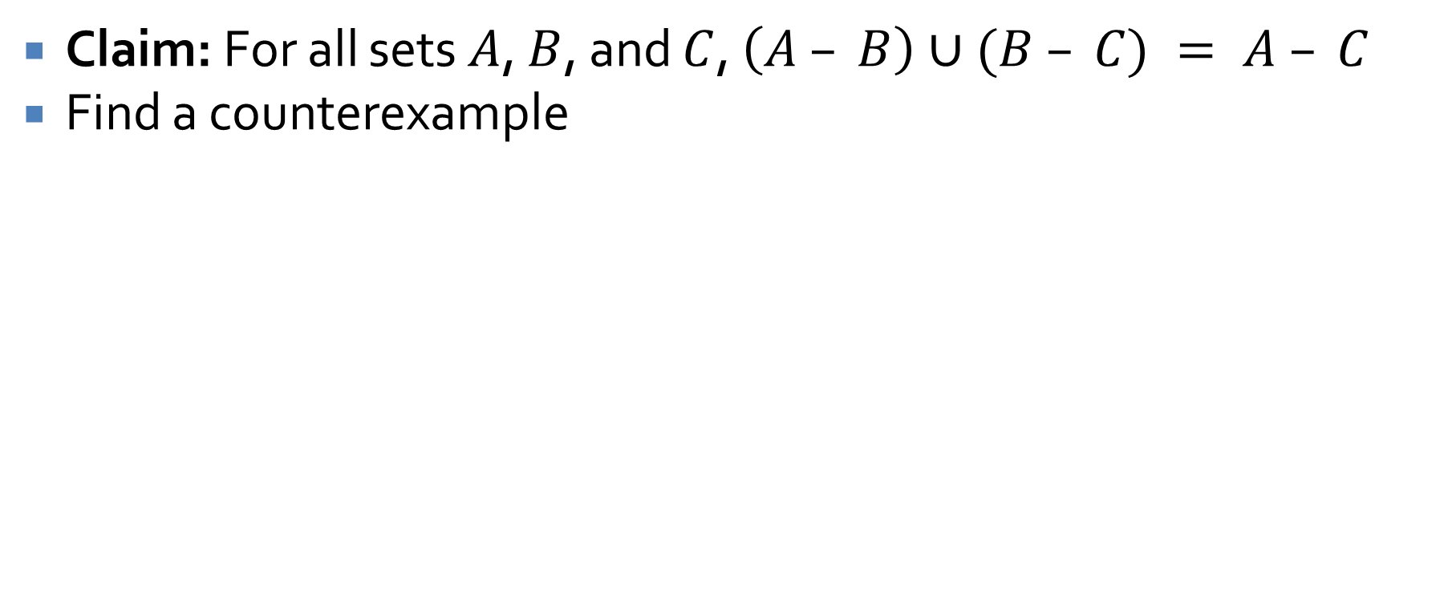
Counterexample example
Claim: For all sets $A$, $B$, and $C$, $\left(A – B\right)∪(B – C) = A – C$
Find a counterexample

Slide 10
Algebraic set identities
We can use the laws of set identities given before to prove a statement of set theory
Be extremely careful (even more careful than with propositional logic) to use the law exactly as stated

Slide 11
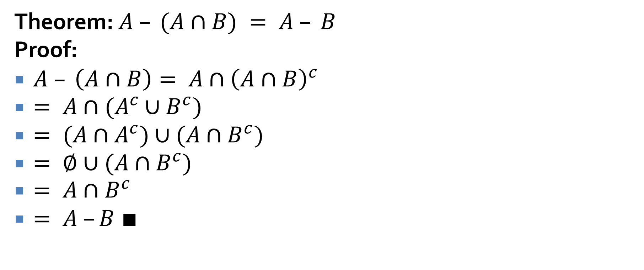
Algebraic set identity example
Theorem: $A – (A∩B) = A – B$
Proof:
$A – \left(A∩B\right)= A∩{\left(A∩B\right)}^{c}$
$= A∩(A^{c}∪B^{c})$
$= (A∩A^{c})∪(A∩B^{c})$
$= ∅∪(A∩B^{c})$
$= A∩B^{c}$
$= A –B ∎$

Slide 12
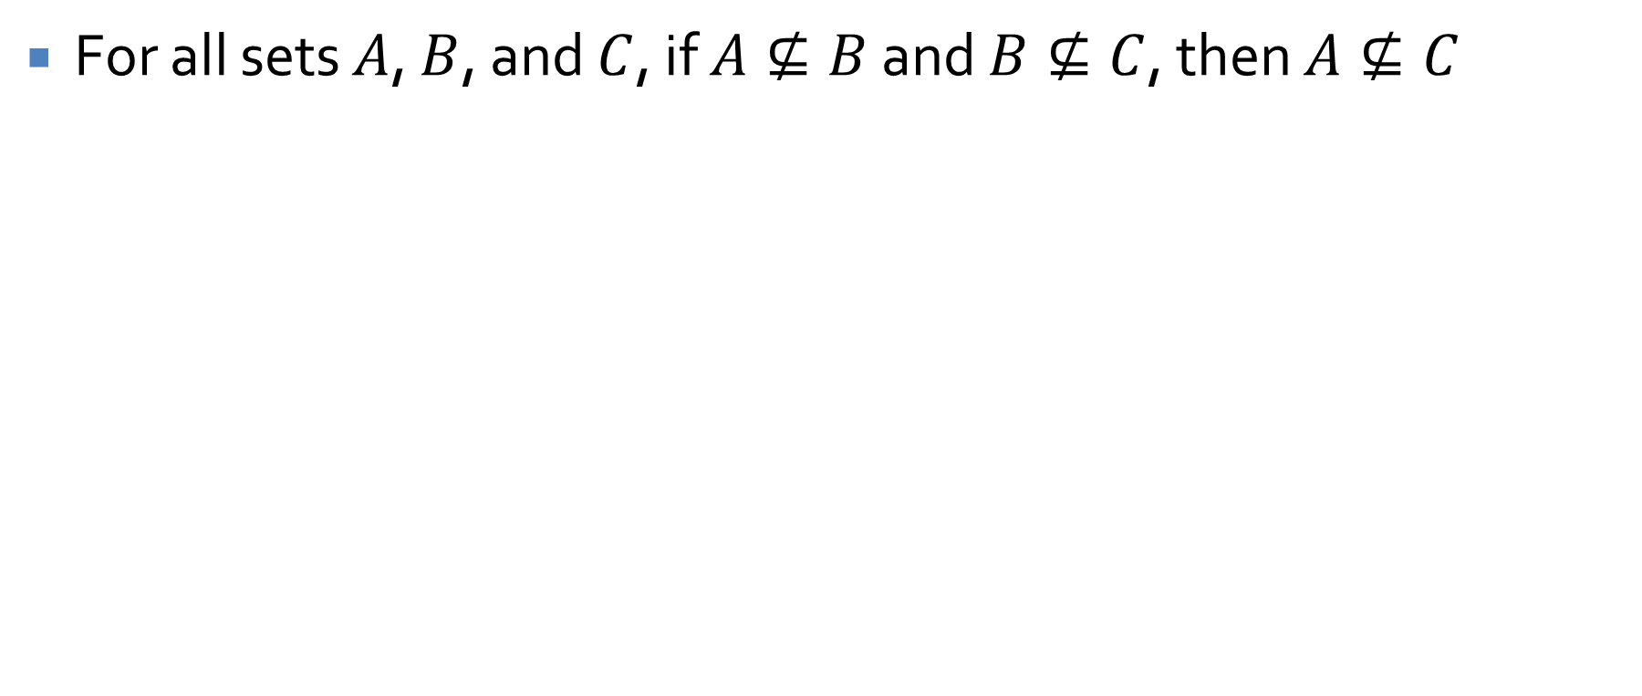
Prove or disprove
For all sets $A$, $B$, and $C$, if $A⊈B$ and $B⊈C$, then $A⊈C$

Slide 13
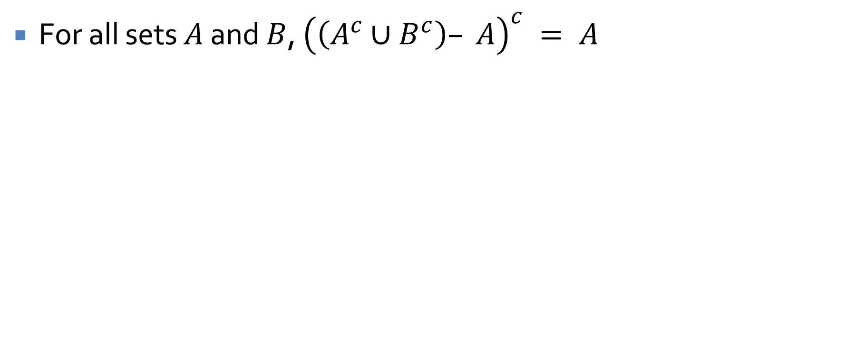
Prove or disprove
For all sets $A$ and $B$, ${\left(\left(A^{c}∪B^{c}\right)– A\right)}^{c} = A$

Slide 14
Russell's Paradox

Slide 15
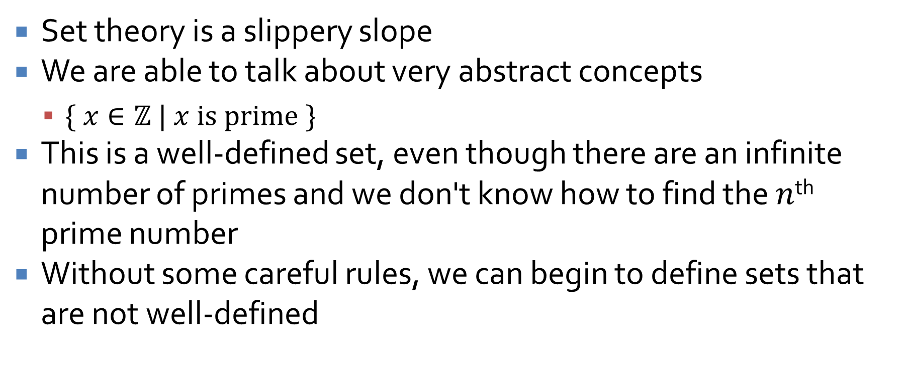
Naïve set theory
Set theory is a slippery slope
We are able to talk about very abstract concepts
  $\{ x∈ℤ | x is prime \}$
This is a well-defined set, even though there are an infinite number of primes and we don't know how to find the $n$^{th} prime number
Without some careful rules, we can begin to define sets that are not well-defined

Slide 16

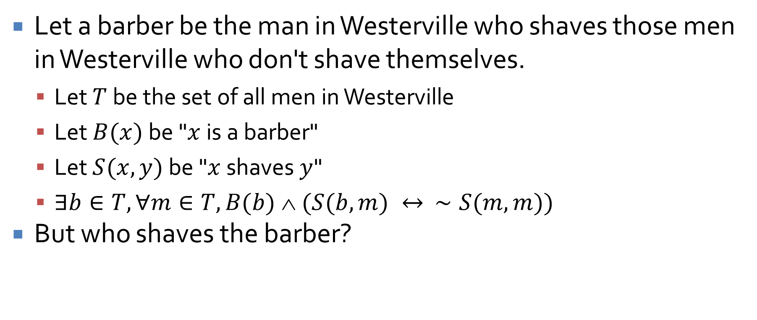
Barber Paradox
Let a barber be the man in Westerville who shaves those men in Westerville who don't shave themselves.
  Let $T$ be the set of all men in Westerville
  Let $B(x)$ be "$x$ is a barber"
  Let $S(x,y)$ be "$x$ shaves $y$"
  $∃b∈T, ∀m∈T, B(b)  (S(b,m) ↔ ∼S(m,m))$
But who shaves the barber?

Slide 17
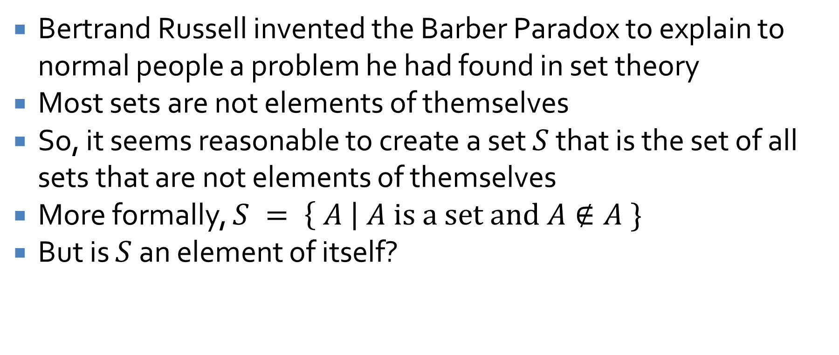
Russell's Paradox
Bertrand Russell invented the Barber Paradox to explain to normal people a problem he had found in set theory
Most sets are not elements of themselves
So, it seems reasonable to create a set $S$ that is the set of all sets that are not elements of themselves
More formally, $S = \left\{ A \right| A is a set and A∉A \}$
But is $S$ an element of itself?

Slide 18
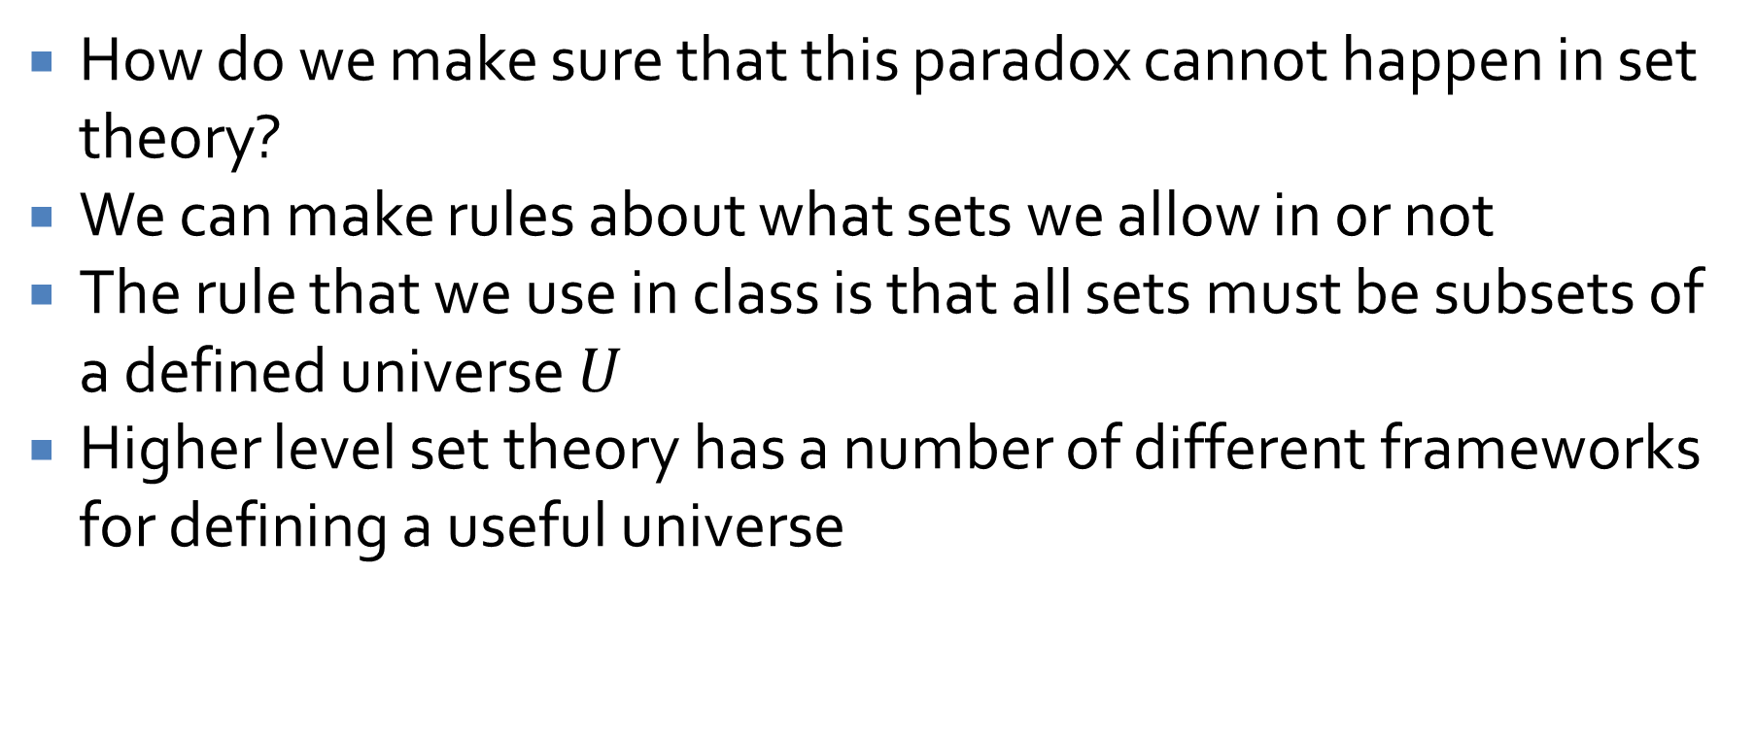
Escaping the paradox
How do we make sure that this paradox cannot happen in set theory?
We can make rules about what sets we allow in or not
The rule that we use in class is that all sets must be subsets of a defined universe $U$
Higher level set theory has a number of different frameworks for defining a useful universe

Slide 19
Halting Problem

Slide 20
Applying the idea again
It turns out that the idea behind Russell's Paradox has practical implications
It wasn't new, either
Cantor had previously used a diagonal argument to show that there are more real numbers than rational numbers
But, unexpectedly, Turing found an application of this idea for computing

Slide 21
Turing machine
A Turing machine is a mathematical model for computation
It consists of a head, an infinitely long tape, a set of possible states, and an alphabet of characters that can be written on the tape
A list of rules saying what it should write and should it move left or right given the current symbol and state
A
1 | 0 | 1 | 1 | 1 | 1 | 0 | 0 | 0 | 0

Slide 22
Church-Turing thesis
If an algorithm exists, a Turing machine can perform that algorithm
In essence, a Turing machine is the most powerful model we have of computation
Power, in this sense, means the ability to compute some function, not the speed associated with its computation

Slide 23
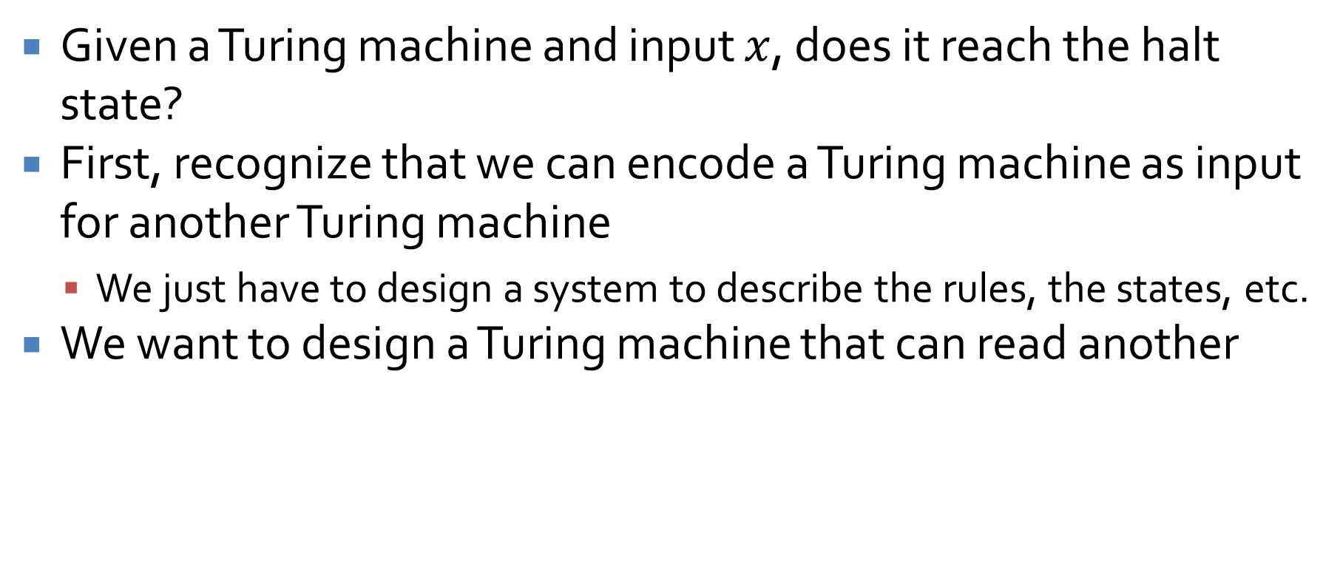
Halting problem
Given a Turing machine and input $x$, does it reach the halt state?
First, recognize that we can encode a Turing machine as input for another Turing machine
  We just have to design a system to describe the rules, the states, etc.
We want to design a Turing machine that can read another

Slide 24
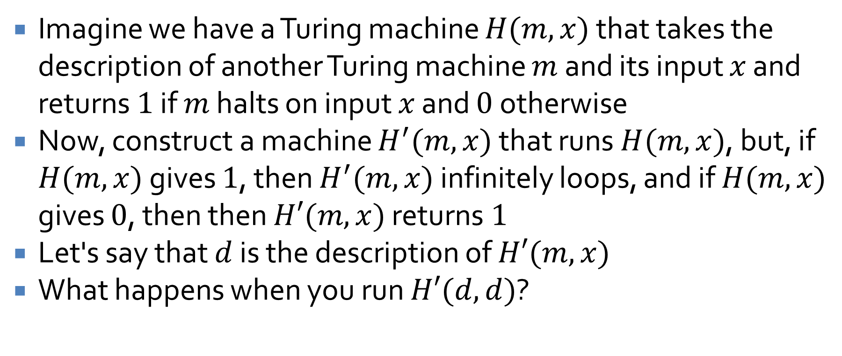
Halting problem problems
Imagine we have a Turing machine $H(m,x)$ that takes the description of another Turing machine $m$ and its input $x$ and returns $1$ if $m$ halts on input $x$ and $0$ otherwise
Now, construct a machine $H^{′}(m,x)$ that runs $H(m,x)$, but, if $H(m,x)$ gives $1$, then $H^{′}(m,x)$ infinitely loops, and if $H(m,x)$ gives $0$, then then $H′(m,x)$ returns $1$
Let's say that $d$ is the description of $H′(m,x)$
What happens when you run $H′(d,d)$?

Slide 25
Halting problem conclusion
Clearly, a Turing machine that solves the halting problem can't exist
Essentially, the problem of deciding if a problem is computable is itself uncomputable
Therefore, there are some problems (called undecidable) for which there is no algorithm
Not an algorithm that will take a long time, but no algorithm
If we find such a problem, we are stuck
… unless someone can invent a more powerful model of computation

Slide 26
And it gets worse!
Gödel used diagonalization again to prove that it is impossible to create a consistent set of axioms that can prove everything about the set of natural numbers
As a consequence, you can create a system that is complete but not consistent
Or you can create a system that is consistent but not complete
Either way, there are principles in math in general that are true but impossible to prove, at least with any given system
You might as well give up on math now

Slide 27
Ticket Out the Door

Slide 28
Upcoming

Slide 29
Next time…
Cardinality
Relations

Slide 30
Reminders
Work on Assignment 4
  Due next Friday
Read 7.4 and 8.1
  Write a three-sentence summary

